Slide 1
FITAKHA
Content + Exercise Intelligence + Recommendation Platform
Working strategy deck
Architecture • Moat • Content flywheel • Platform licensing • Business model
Progress with Purpose

Slide 2
Core objective | Description
1. Make fitness accessible and achievable for everyone | Help people build consistent fitness habits regardless of experience, equipment, or location. Provide clear exercise demonstrations, proper technique, common mistakes, and adaptable workouts through the Be a Fitakha channel and platform—supporting movement at home, in office, in the gym, or while traveling.
2. Deliver personalized, adaptive fitness guidance | Build the Fitakha Fitness Intelligence Engine to recommend workouts based on individual goals, abilities, preferences, equipment, and relevant health and recovery data when available. Adapt recommendations as users progress, supporting weight management, strength, mobility, general fitness, and sports preparation through Fitakha’s app and APIs for other platforms.
3. Connect people with expertise and ongoing support | Create an integrated ecosystem where users can discover coaches and, over time, nutritionists, dietitians, and other qualified wellness professionals. Combine educational content, professional guidance, and progress tracking to help users sustain healthy habits, while giving professionals a platform to reach and serve clients.

Slide 3
Persona | Situation and goal | Fitakha Recommendation Engine use case | Be a Fitakha channel use case
1. Bella Bear — Beginner seeking weight management | New to exercise and unsure where to start. Wants to manage weight, improve fitness, and build consistency. | Creates manageable beginner workouts using fitness level, health history, time, and equipment. Adapts difficulty based on completion, effort, and feedback; wearable data is optional. | Beginner follow-along workouts, exercise basics, easier variations, and stories about small, consistent steps. Episode: “Bella Takes Her First Step.”
2. Theo Tortoise — Desk professional with stiffness | Spends long hours at a computer, experiences neck, shoulder, or hip stiffness, and has limited exercise time. | Uses work habits, movement assessments, reported discomfort, and available time to recommend short mobility and strength sessions, with office and travel alternatives. | Desk movement breaks, posture education, technique demonstrations, and short routines for busy professionals. Episode: “Theo Is Stuck in Loading.”
3. Sophia Owl — Building strength and balance after 50 | Wants to regain strength, maintain balance, and feel confident climbing stairs, carrying groceries, and performing daily activities. | Personalizes strength, balance, and mobility work using current ability, health history, and equipment. Provides supported variations and progresses according to performance. | Accessible strength and balance demonstrations tied to everyday activities, with clear instructions and modifications. Episode: “Sophia Builds Everyday Strength.”
4. Diego Jaguar — Recreational athlete preparing for sport | Plays basketball or another sport and wants to improve strength, agility, and conditioning before an upcoming competition. | Builds training around the sport, event date, experience, practice schedule, and recovery. Progresses exercise demands as readiness improves and adjusts around games. | Sport-focused strength, agility, landing technique, conditioning, and recovery education. Episode: “Diego Gets Ready for Game Day.”
5. Arjun Lion — Experienced exerciser pursuing strength and muscle | Trains regularly and wants continued progress while balancing training intensity and recovery. | Uses recent workouts, training volume, soreness, goals, and equipment to determine today’s session focus, progression, substitutions, or lighter training. | Lifting technique, progression, common mistakes, and recovery education, supported by stories about discipline and sustainable progress. Episode: “Arjun Learns When to Push—and When to Recover.”
6. Maya Elephant — Homemaker regaining fitness at home | Spends much of the day cooking, doing household work, and caring for family. Has no gym access, limited personal time, and posture concerns. | Creates short home workouts using body weight and available supports or equipment. Uses movement assessments and symptom feedback to select suitable mobility, strength, and balance exercises, with flexible activity blocks. | Home workouts, posture and movement education, easier exercise variations, and movement breaks demonstrated in a clear space away from active cooking. Episode: “Maya Makes Time for Herself.”

Slide 4
Aspect | Use case
Persona and situation | Maya spends much of her day at home cooking, cleaning, and caring for her family. She has no gym access, little equipment, and limited uninterrupted time for herself.
Her goal | “I want to regain my strength and fitness, improve my posture, and feel more comfortable doing everyday tasks.”
Posture concern | She reports rounded shoulders or discomfort after prolonged standing and leaning over kitchen counters. These are inputs to assess—not a diagnosis inferred from her homemaker role.
What the engine collects | Goals, exercise history, available time, equipment, reported discomfort, relevant health history, and movement-assessment findings when available. Wearable data is optional.
What the engine recommends | Short home sessions, with the option to split activity into manageable blocks. Selects mobility, strength, and balance exercises based on her assessed needs, using body weight, a stable chair, a wall, or resistance bands if available.
How it personalizes | Adjusts exercise selection, range of motion, support, and difficulty using her ability and feedback. Posture-related selections follow assessment findings; concerning symptoms prompt professional assessment.
How it progresses | Builds consistency first, then gradually increases repetitions, resistance, or session length as her performance and recovery allow.
Fitakha channel content | Short home workouts, posture and movement education, exercise demonstrations, easier variations, and practical tips for taking movement breaks during household routines. Demonstrations use a clear space away from active cooking, hot surfaces, and slippery floors.
Example episode | “Maya Makes Time for Herself” — Maya realizes she schedules time for everyone except herself. She starts with a brief movement break and builds toward a regular home routine.
Success measures | Consistency, improved exercise technique, greater strength and movement confidence, and easier performance of daily activities—not appearance alone.

Slide 5
Main navigation | What it contains | Purpose
Home | Brand introduction, “Find Your Starting Point” questionnaire, featured programs, exercise videos, coach highlights | Quickly explain Fitakha and help visitors take their first step
Find Your Fit | Guided questionnaire, relatable personas, fitness goals, available equipment, time and preferences | Help people explore suitable starting options
Workouts & Learn | Fitness programs, searchable exercise library, Fitakha YouTube videos, technique guides, FAQs | Bring exercise instruction and practical answers together
Find an Expert | Coaches, nutritionists/dietitians, and eventually other specialists | Connect visitors with personalized support
Shop | Fitakha apparel and future accessories | Give merchandise a clear home
About Fitakha | Our story, mission, approach, team profiles | Build trust and explain what makes Fitakha different

Slide 6
Persona card | What the visitor is looking for | Suggested destination
“I’m starting from scratch” | Simple instructions and a manageable routine | Beginner program collection
“I want to manage my weight” | Consistency, activity and nutrition support | Goal-based programs and nutrition directory
“I spend most of my day sitting” | Movement breaks and posture education | Mobility guides and beginner strength options
“I’m getting back into exercise” | A gradual restart | Return-to-exercise starting options
“I want to get stronger” | Structured resistance training | Strength programs by experience and equipment
“I want better balance and mobility” | Confidence in everyday movement | Balance and mobility collection
“I’m training for a sport or event” | More specific preparation | Sport-focused programs and coach matching
“I need workouts for home or travel” | Convenient sessions with limited equipment | Short, equipment-filtered workouts

Slide 7
Fitakha Product Family
Fitakha is defensible product that has relationship between Content Library, Exercise Graph & Intelligence Engine
Content Library
Fitakha demonstrations, tutorials, Shorts and workouts — with YouTube as an initial hosting/distribution channel.
Exercise Knowledge Graph
Structured exercise ontology: movement, muscles, equipment, difficulty, safety flags, regressions, progressions and alternatives.
Intelligence Engine
Hybrid recommendation layer combining deterministic rules with AI reasoning, personalization, adaptation and explanation.
Video tells someone HOW to do an exercise
Videos demonstrate Setup, Execution, Common mistakes, Easier Variation, Harder Variation, Safety Cues
Can generate YouTube/Instagram/Facebook views, subscribers, ad revenue and awareness for Fitakha.
Attract people, produce exercise content
Metadata tells the system WHAT the exercise is
Exercise knowledge base knows the metadata about the exercise a machine-understandable exercise object
Organizes the content into structured fitness knowledge
The intelligence engine decides WHO should do it, WHEN, WHY, and what should come next.
Identifies right variation for people with different age, fitness level, experience, goals, etc.
Use the knowledge + individual data to make personalized decisions and sends the appropriate Fitakha content back to the user
CONTENT → KNOWLEDGE → INTELLIGENCE → USER OUTCOME → BETTER INTELLIGENCE
Notes:
Fitakha's structured exercise knowledge: A structured exercise library that understands how exercises relate to movement patterns, muscles, equipment, difficulty, goals, safety considerations, regressions, progressions and alternatives.
Behind that video, Fitakha knows something like:
Attribute - Fitakha metadata
ExerciseBulgarian - Split Squat
Primary muscles - Quads, glutes
Secondary - Hamstrings, core
Movement - Knee-dominant unilateral
Equipment - Bench + dumbbells
Skill - Intermediate
Stability demand - High
Balance demand - High
Goal - Strength / hypertrophy / stability
Regression - Supported split squat
Progression - Weighted Bulgarian split squat
Knee stress consideration - Moderate
Training phase - Depends on user/program
Video - Fitakha YouTube URL
-----------------------------------------------------------------------------------------
Fitakha Intelligence Engine
Suppose two people ask:
Person A
"I'm 27, experienced, training for hypertrophy, slept well, recovery is good, have dumbbells and a bench."
The engine might select:
Bulgarian Split Squat → 3 × 8–10
and return your Fitakha instructional video.
But Person B says:
"I'm 62, beginner, poor balance today, training at home and only have resistance bands."
The engine might not recommend the Bulgarian split squat at all.
Instead:
Supported Split Squat → 2 × 8
with the appropriate Fitakha instructional content.
That's where the real product begins.

Slide 8
Fitakha Reference Architecture
Fitakha owns the canonical IDs and intelligence; content providers remain replaceable.
1. User / Platform Data
Input: goal=STRENGTH • experience=BEGINNER • time=30 min • equipment=DUMBBELLS • readiness=LOW • HR=x • RHR=x • Sleep=xyz
Example Recommendation
Goblet Squat 2×10 • One-Arm DB Row 2×10/side • DB RDL 2×10 • Incline Push-Up 2×8–10 • Dead Bug 2×6/side
2. Safety + Eligibility Rules
Apply hard constraints: available equipment, experience level, precaution flags, session duration and recovery limits.
Canonical Mapping
Goblet Squat
EX-SQUAT-GBLT-001
DB RDL
EX-HINGE-RDL-001
Why AI?
“Readiness is low today, so Fitakha reduced volume while preserving the main movement patterns.”
3. Canonical Exercise Graph
Eligible candidates: Goblet Squat, DB RDL, Incline Push-Up, One-Arm DB Row, Dead Bug — each with a Fitakha exercise ID.
Fitakha App
Content resolver → Fitakha demonstration/tutorial → YouTube-supported player for V1.
Partner Platform
Same recommendation ID → mapped partner exercise/video. If missing → optional Fitakha-content fallback.
4. AI Recommendation Layer
AI assembles a balanced session, reduces intensity/volume for low readiness, sequences exercises and explains the choices.
5. API + Content Resolution
Return sets/reps/rest + canonical IDs + content source. Use platform video if mapped; otherwise return Fitakha content.
Same intelligence. Different content source. No need for the AI to search YouTube at runtime.

Slide 9
Fitakha Ecosystem + Minimum-Cost Tech Stack
Start with free/low-cost managed tools; keep Fitakha metadata and AI logic independent of any one video platform.
Content Repository
YouTube channel
Shorts + tutorials + playlists
YouTube Studio analytics
YouTube Create / Canva for low-cost editing
Fitakha Website
Next.js / React
Vercel or Cloudflare Pages
SEO pages by exercise, goal and equipment
Embed YouTube player for V1
App / PWA First
Mobile-friendly PWA before native app
Reuse same API and content catalog
Native app later only after usage proves demand
Partner Platforms
B2B API clients
Their users + their content mappings
Fitakha returns recommendation IDs and logic
Future
Dedicated video/CDN only if premium app experience requires it
Fitakha Data Layer
Supabase Postgres for Exercise Knowledge Graph, Content Catalog, users, mappings and audit logs.
Start with simple tables; use CSV/Sheets import for content ops.
AI Engine Layer
Serverless API: deterministic filters first, then low-cost LLM for personalization, explanation and substitutions.
Cache repeated responses; avoid YouTube search at runtime.
Ops + Analytics
GitHub + CI/CD
PostHog or GA4
Sentry/logging
Stripe later for paid plans
Admin Tools
Retool/Appsmith later
Start with Supabase dashboard + spreadsheets
Human review for exercise metadata
Cost discipline: YouTube handles video hosting/discovery • PWA before native mobile • serverless before dedicated servers • Supabase before custom infrastructure • rules before AI • GPT-5 Mini-style low-cost model for V1 • caching + batch generation to reduce token spend.
Notes:
SEO - Search Engine Optimization

Slide 10
The Moat
Structured intelligence around the content is the MOAT
Exercise Knowledge Graph
What Fitakha knows?
Decision Intelligence
How Fitakha decides what to recommend?
Content Flywheel
How Fitakha teaches, attracts users and continuously builds content
Canonical Fitakha exercise IDs
Movement / muscle / equipment relationships
Regression, progression and substitution graph
Difficulty, balance, mobility and complexity metadata
Matches user context to eligible exercises
Uses rules for hard constraints and safety
Uses AI for personalization and explanation
Learns which recommendations/content are useful
One exercise creates many reusable assets
App usage reveals high-interest problems
Those problems become new content topics
Content drives discovery back to Fitakha
KNOWLEDGE → INTELLIGENCE → CONTENT → MORE USERS/DATA → BETTER KNOWLEDGE

Slide 11
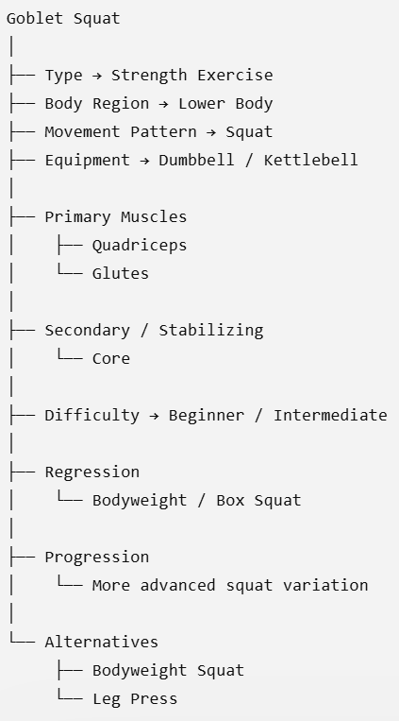
The Moat
Structured intelligence around the content is the MOAT
Exercise Knowledge Graph
What Fitakha knows?
Decision Intelligence
How Fitakha decides what to recommend?
Content Flywheel
How Fitakha teaches, attracts users and continuously builds content
Canonical Fitakha exercise IDs
Movement / muscle / equipment relationships
Regression, progression and substitution graph
Difficulty, balance, mobility and complexity metadata
Matches user context to eligible exercises
Uses rules for hard constraints and safety
Uses AI for personalization and explanation
Learns which recommendations/content are useful
One exercise creates many reusable assets
App usage reveals high-interest problems
Those problems become new content topics
Content drives discovery back to Fitakha
KNOWLEDGE → INTELLIGENCE → CONTENT → MORE USERS/DATA → BETTER KNOWLEDGE

Slide 12
Exercise Graph + Content Model
Example: Goblet Squat remains one canonical exercise even as content changes.
Demonstration
30–60 sec clean form video
EX-SQUAT-GBLT-001
Goblet Squat
Identity
Classification
Muscles
Equipment
Difficulty
Coaching
Safety
Regression
Progression
Alternatives
YouTube Provider
Public discovery / embeds / analytics
Tutorial
Setup, execution, cues, breathing
Mistakes / Shorts
One mistake can become one discovery asset
Future Provider
Dedicated CDN or partner content without changing the exercise ID.
Workout
Same exercise linked to multiple sessions
Languages
English, Hindi, Spanish, silent demo, etc.

Slide 13
Exercise Graph + Content Model
Example: Goblet Squat remains one canonical exercise even as content changes.
Demonstration
30–60 sec clean form video
EX-SQUAT-GBLT-001
Goblet Squat
Identity
Classification
Muscles
Equipment
Difficulty
Coaching
Safety
Regression
Progression
Alternatives
YouTube Provider
Public discovery / embeds / analytics
exercise_id: EX-SQUAT-GBLT-001 canonical_name: Goblet Squat movement_pattern: SQUAT primary_muscles:
- Quadriceps
- Gluteus Maximus
equipment:
- Dumbbell
difficulty: BEGINNER
content: demonstration: youtube_video_id: abc123 duration_seconds: 42
language: EN
content_version: 1.0
Tutorial
Setup, execution, cues, breathing
Mistakes / Shorts
One mistake can become one discovery asset
Future Provider
Dedicated CDN or partner content without changing the exercise ID.
Workout
Same exercise linked to multiple sessions
Languages
English, Hindi, Spanish, silent demo, etc.

Slide 14
Why AI Still Matters?
AI is the intelligence layer — not the exercise database.
1. User Context
Goal, experience, equipment, time, readiness, preferences
2. Rules
Filter ineligible exercises and enforce hard constraints
3. Exercise Graph
Return controlled candidate exercises
4. AI
Assemble, adapt, sequence and explain the workout
5. Content Resolver
Attach the right Fitakha or platform media
Principle: AI chooses from Fitakha’s controlled universe rather than inventing exercises from scratch.

Slide 15
B2B Platform Integrations Models
Recommendation intelligence and content can be licensed independently.
Fitakha Content
Best for a new/small platform.
Fitakha recommends canonical exercises and returns Fitakha instructional content.
Lowest integration burden.
Platform Content
Best for established platforms.
Customer maps its exercise IDs to Fitakha canonical IDs. Fitakha recommends; customer displays its own media.
Hybrid
Recommended default.
Use customer content when mapped; fall back to Fitakha content when the customer has a gap.

Slide 16
Business Model
Multiple monetization paths can sit on the same core assets.
Consumer
Fitakha Free — basic exercise discovery/workouts
Fitakha Plus — adaptive recommendations, richer personalization, wearables
Content drives acquisition through YouTube/search
B2B / Coaches
Fitakha Intelligence API — recommendation engine only
Fitakha Content API — exercise metadata/content
Fitakha Complete API — intelligence + content
Media / Ecosystem
YouTube advertising when eligible
Potential sponsorships and affiliates
Content reduces acquisition cost while building brand trust

Slide 17
Fitakha Flywheel
Content and product usage should continuously strengthen each other.
Exercise
Intelligence
YouTube / Social
Content
Personalized
Recommendations
Problem & Demand
Signals
App / Platform
Usage
Content → Users → Usage → Intelligence → Better Product + Better Content → More Users

Slide 18
One Exercise → Many Assets
Record once; reuse across discovery, education, app instruction and workouts.
App Demo
30–60 sec
Master Recording
Clean demonstration
Front / side / 45°
Correct form
Common mistakes
Regression
Progression
Spoken explanation
Distribution
Fitakha App
Fitakha Website
YouTube Search
YouTube Shorts
Future languages
Partner platforms
Shorts
20–45 sec
Tutorial
3–6 min
Workout
10–40 min

Slide 19
Design

Slide 20
Taxonomy
Common language for describing exercises, users, goals, equipment, conditions, and movements. Organized labels for Fitakha to understand consistently
Example | Exercise | Body Area | Muscle | Movement | Equipment | Difficulty
 | Bodyweight Squat | Lower Body | Quads, Glutes | Squat | None | Beginner
 | Goblet Squat | Lower Body | Quads, Glutes | Squat | Dumbbell/Kettlebell | Beginner
 | Bulgarian Split Squat | Lower Body | Quads, Glutes | Lunge | Dumbbells | Intermediate
 | Bench Press | Upper Body | Chest, Triceps | Push | Barbell | Intermediate
User: “I want to strengthen my legs at home. I'm a beginner and only have dumbbells.” In this scenario Fitakha doesn’t need AI to search hundreds of exercises. It first uses the taxonomy:
Goal: Strength -> Body Area: Lower Body -> Experience: Beginner -> Available Equipment: Dumbbells -> Movement: Squat/Lunge/etc. -> Eligible Exercises: Bodyweight Squat: Yes, Goblet Squat: Yes, Bulgarian Split Squat → maybe, depending on ability, Leg Press → NO (machine unavailable), Bench Press → NO (wrong body area)
Here the AI works only with the appropriate exercises and decides things such as which exercises to combine, sequence, sets/reps, rest periods, and how to explain the workout.
Taxonomy = What things ARE
Rules Engine = What is ALLOWED/APPROPRIATE
AI = What is BEST for this particular user
User: 55 years old, beginner, knee discomfort, wants weight loss, home workout, dumbbells available.
Taxonomy identifies: lower-body exercises, low-impact exercises, dumbbell exercises, beginner exercises, knee-dominant movements, etc.
Rules Engine filters: remove exercises that don't fit the user's constraints or equipment.
AI then reasons: "From the safe and relevant exercises remaining, what is the best 30-minute workout for this person today?“
Taxonomy organizes → Rules filter → AI personalizes.

Slide 21
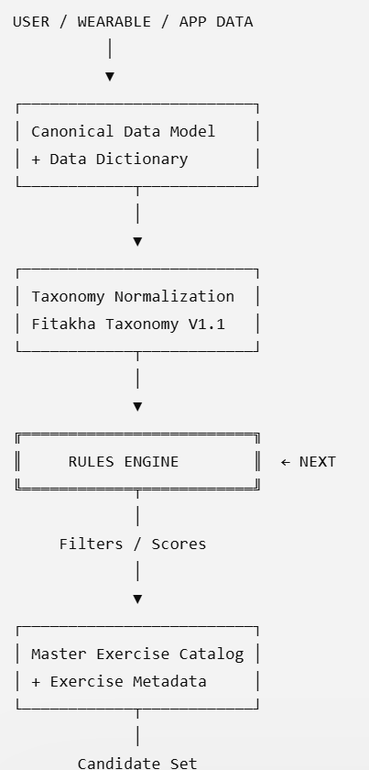
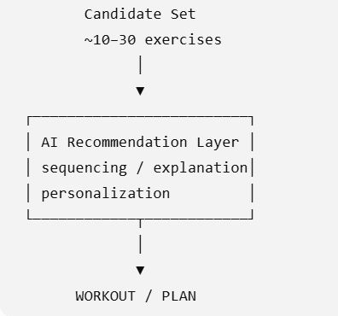
Rules Engine

Slide 22
Rules Engine
Divided into several layers
Rule layer | Question it answers | Example
1. Safety / Eligibility | What must we exclude? | Active knee pain → exclude high-impact knee-dominant exercises
2. Readiness | How hard should today's workout be? | Poor sleep + low HRV → reduce intensity
3. Goal | What type of training is appropriate? | Hypertrophy → greater resistance-training emphasis
4. Experience | How complex can exercises be? | Beginner → favor stable/simple movements
5. Training Environment | What can the user actually perform? | Hotel room → bodyweight/band exercises
6. Workout Allocation | Upper/lower/core/full body? | Recent chest workout → decrease chest priority
7. Movement Pattern | What movement families are required? | Full body → squat + hinge + push + pull + core
8. Exercise Selection | Which catalog entries qualify? | Filter catalog using metadata
9. Exercise Scoring | Which qualified exercises are best? | Goal match + equipment + skill + recovery
10. Workout Construction | How should they be arranged? | Warm-up → stability → strength → power → cooldown

Slide 23
Rules Engine
Fitakha should deterministically reason first
Step1 – Safety
Knee pain
→ remove high-impact plyometrics
→ remove exercises exceeding allowed knee-load classification
Example:
Master Exercise Catalog contains over 1,000 exercises
Age: 45
Experience: Beginner
Goal: Weight Loss
Environment: Home
Equipment: Resistance Bands
Knee Pain: Mild
Sleep: 5.5 hours
HRV: 18% below baseline
Last Workout: Lower Body Yesterday
Available Time: 30 minutes
Rules Engine
Step2 – Readiness
Poor sleep+HRV below baseline
→ LOW/MODERATE readiness
→ intensity ceiling = MODERATE
1,000
↓ safety
650
↓ equipment
180
↓ experience
100
↓ movement / muscle needs
45
↓ recent workout + readiness
18
Step3 – Recent Training
Lower body performed yesterday
→ reduce lower-body training load
Step4 – Goal
WEIGHT_LOSS
→ favor full-body / metabolic resistance training
But only 18 are going to the AI and AI might select:
Step 5 — Equipment
HOME
Resistance bands available
→ BODYWEIGHT + BAND exercises
Band Chest Press
Band Seated Row
Glute Bridge
Standing Pallof Press
Supported Single-Leg Balance
Band Lateral Walk
Engine will search:
Step 6 — Exercise Catalog query
training_goal = WEIGHT_LOSS
equipment ∈ [BODYWEIGHT, RESISTANCE_BAND]
difficulty ∈ [BEGINNER]
impact != HIGH
contraindication != KNEE_PAIN
intensity <= MODERATE
and determine sequencing, sets/reps, rest, coaching instructions, etc.
Fitness Engine Moat is Why this exercise? Why not that exercise?
Notes:
Fitakha Rules Engine Specification V1.0
It should contain six core components:
Rule Data Model — how a rule itself is represented in JSON/YAML.
Safety & Contraindication Rules — hard exclusions and escalation conditions.
Readiness Rules — HRV/RHR/sleep/recovery/mood/recent workload.
Workout Strategy Rules — goal → workout type/body-region/movement allocation.
Exercise Filtering & Scoring Rules — how Master Exercise Catalog entries get filtered/ranked.
Decision Trace / Explainability — record why every exercise was selected or rejected.
The sixth one will become particularly valuable commercially.
For example:
{
"exercise": "Barbell Back Squat",
"eligible": false,
"reason_codes": [
"KNEE_PAIN_CONTRAINDICATION",
"BEGINNER_COMPLEXITY_LIMIT"
]
}
OR
{
"exercise": "Resistance Band Row",
"eligible": true,
"score": 87,
"reason_codes": [
"EQUIPMENT_MATCH",
"BEGINNER_APPROPRIATE",
"PULL_PATTERN_REQUIRED",
"GOAL_MATCH"
]
}
That means Fitakha isn't merely producing AI recommendations. It can explain:
Why this exercise? Why not that exercise?
That becomes part of the Fitness Intelligence Engine moat.

Slide 24
Rules Engine
The Rules Engine takes what we know about the user and applies explicit rules.
Example:
Rule 1 — Goal/body area
User wants legs → consider lower-body exercises.
1,000 exercises → perhaps 250
Rule 2 — Location/equipment
User is at home and has only dumbbells → remove exercises requiring machines, cables, barbells, etc.
250 → perhaps 90
So it is narrowed down like:
Goblet Squat YES
Leg Press NO because machine required
Barbell Back Squat NO because barbell unavailable
Rule 3 — Experience
User is a beginner → remove exercises classified as advanced.
90 → perhaps 60
Rule 4 — Injury/condition constraints
User reports knee pain.
Don't automatically prescribe certain high-impact or high-knee-load movements; flag or exclude exercises according to the safety rules and available assessment data.
60 → perhaps 35 appropriate candidates
From 1,000 exercises→ Taxonomy lets us understand/classify them→ Rules Engine narrows them to ~35 candidates→ AI chooses and assembles the workout
So instead of asking to figure out from 1,000 exercises we give 35 exercises that satisfy our deterministic rules. And ask AI to create the best 30-minute lower-body strength workout for the user's goals, recent training, preferences, and readiness.
Taxonomy tells us WHAT an exercise is. Rules Engine determines WHETHER it qualifies. AI decides HOW to use the qualified exercises.
This separation is critical to the architecture because we don't want the LLM making every safety, equipment, and eligibility decision by itself.

Slide 25
Archive

Slide 26
Fitakha Channel YouTube Discovery
How people who do not already know your channel find your videos on YouTube
Exercise-content strategy: Discovery is very important because you don't want to depend only on people searching for “Fitakha.” You want YouTube to put your exercise videos in front of people looking for solutions.
Discovery route | Example
YouTube Search | Someone searches “how to do Bulgarian split squat correctly”
Suggested Videos | Your “5 Bulgarian Split Squat Mistakes” appears beside another fitness video
Home/Browse | YouTube recommends “Are You Squatting Correctly?” on someone's home screen
Shorts Feed | Your 30-second “Knee collapsing during squat? Try this” appears while someone scrolls Shorts
Playlists / Channel | Someone watches your “Exercise Library → Legs” playlist
External Discovery | Someone reaches the video through Google, Fitakha, WhatsApp, Instagram, etc.
Ex: SQUAT
Identify: “What muscles does a squat actually work?”
Classify: “Squat: strength, stability or power exercise?”
Teach: “How to squat correctly — beginner guide.”
Correct: “5 squat mistakes that may be hurting your progress.”
Progress: “Bodyweight squat → goblet squat → barbell squat.”
Shorts
“Your knees doing THIS during squats?”
“Stop making this squat mistake.”
“Can you pass this 20-second squat test?”
Search: The viewer already has an intention. For example, “proper deadlift form.” You need a clear title, description, spoken content, and video that accurately answers that question.
Recommendation: The viewer wasn't necessarily looking for you. YouTube decides your video might interest them based on what they watch and how viewers respond to your content. Here, the topic, thumbnail/title, opening seconds, watch time, satisfaction and whether people continue watching matter greatly.
Exercise Content Structure: One exercise can create multiple discovery opportunities. Identify → Classify → Teach → Correct → Progress
Fitakha Content Engine: 1 exercise → 1 canonical exercise video → 3–5 educational videos → 5–10 Shorts → app exercise asset → playlist → related workout videos.
YouTube Discovery and the Fitakha exercise library can reinforce each other, rather than producing separate contents for the app and YouTube.

Slide 27
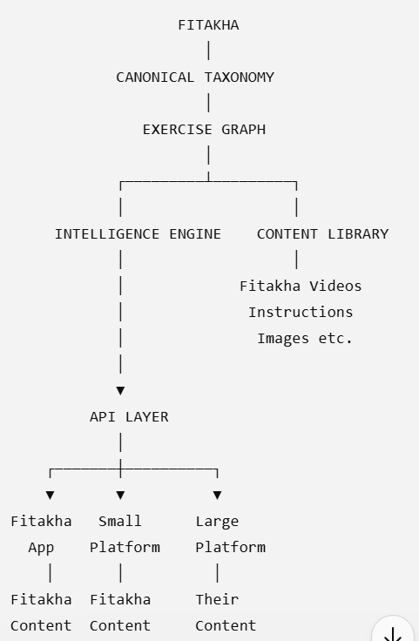
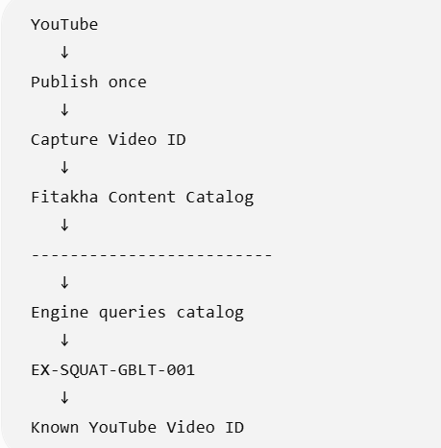
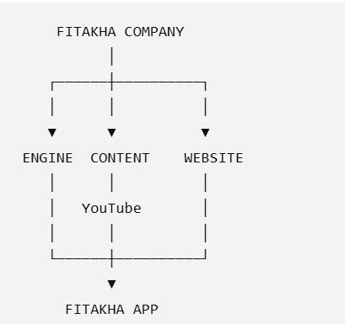

Slide 28
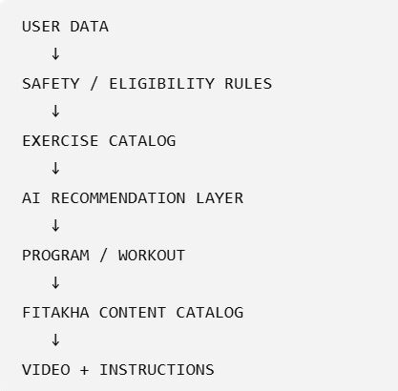
Notes:
The key is that AI should choose from Fitakha's controlled universe, rather than freely inventing exercises or searching YouTube every time.
That gives you the best of both worlds: AI personalization without losing control.
For V1, I would use AI mainly for workout construction, adaptation, explanation, substitutions, progression suggestions, and natural-language interaction. I would keep safety exclusions, exercise eligibility, and key programming constraints deterministic wherever possible.
So the answer is: yes, Fitakha still needs AI — but AI becomes the intelligence layer, not the database. That is actually a stronger architecture than relying on AI alone.

